Slide 1
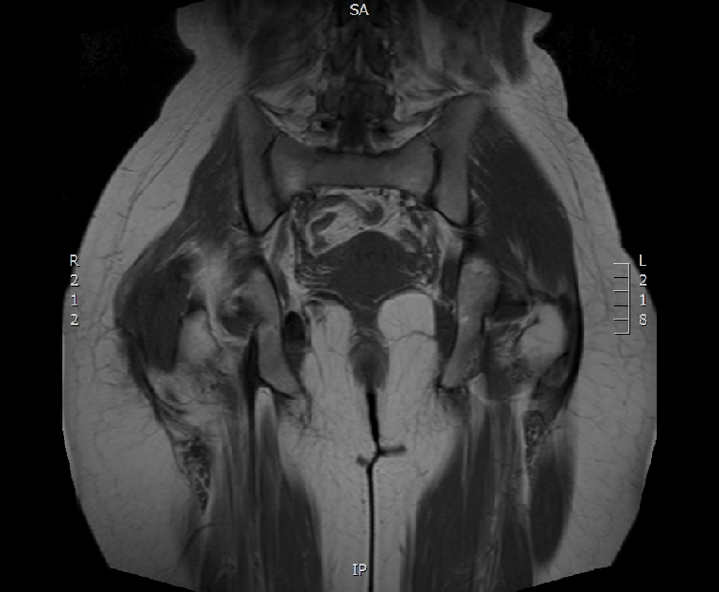
Figure 2. A control MRI performed in May 2012 describing a progressive recurrence of the disease

